Slide 1
Data types

Slide 2
String
“PLP1”, ‘PLP1’
GENE1, GENE2
SOX9, SOX10, …
f“SOX7{i}”
data_path = “\User\Documents\”
gene_list_name = “SenMaya.xlxs”
data_path + gene_list_name = “\User\Documents\SenMaya.xlxs”

Slide 3
Integer
1, 2
A = 1
B = 2
A+B =3
Floats
0.1,

Slide 4
List
empty_list = []
gene_list_oligio_list = [“PLP1”, “SOX10”,...]
gene_list_neuron_list = [“GFAP”, “GFAP1”,...]
adata.obs[‘cell_type’] = [“Oligo”, “Oligo”, “Astro”...]
gene_list_oligio_list + gene_list_neuron_list = [“PLP1”, “SOX10”,“GFAP”, “GFAP1”]

Slide 5
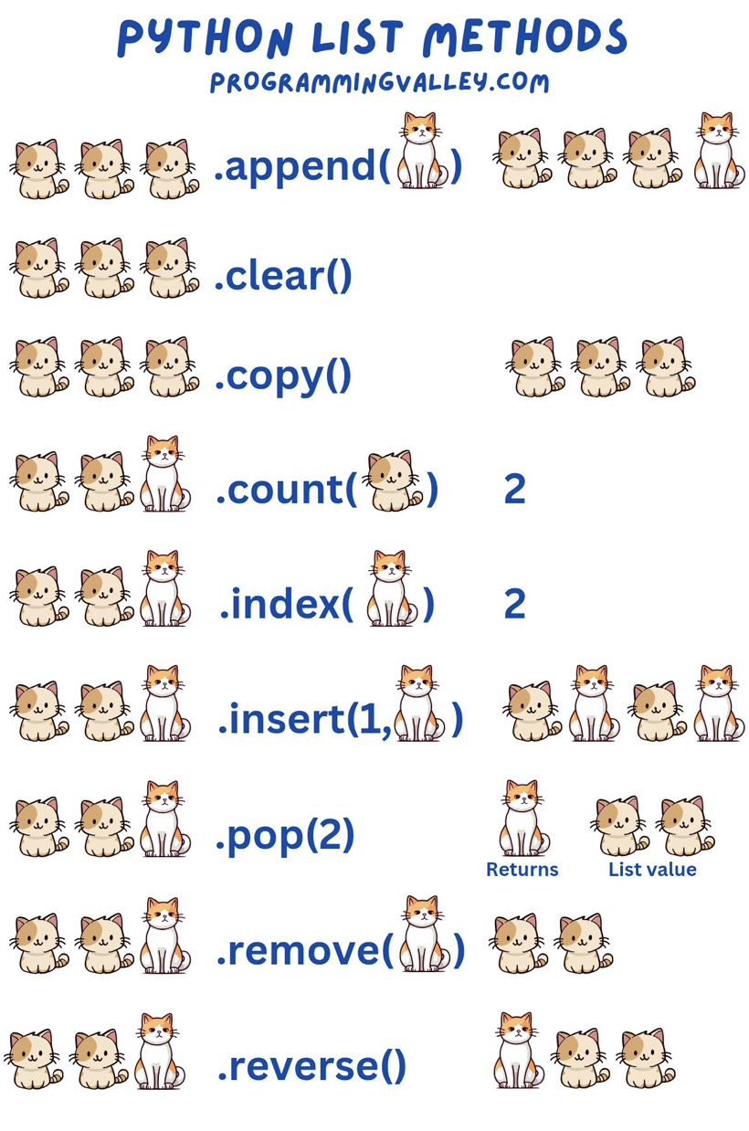

Slide 6
pandas.Dataframe
Import pandas as pd
Sen_mayo_df = pd.read_excel(data_path)
Sen_mayo_df.head()
Sen_mayo_df[“Genes”] = [PLP1, SOX10]
Genes | Description | Number
PLP1 | Oligo gene | 1
SOX10 | pathway | 2

